Slide 1
Wednesday, December 7, 2016
Write In Your Agenda:
Write In Your Monitoring Log:
CW:
Seasons Brainpop video
The Seasons – Earth’s Seasons worksheet.
Reasons for Seasons worksheet
HW:
None.
Response to Warm-Up:
What causes the Earth’s seasons?
You will need:
Pencil

Slide 2
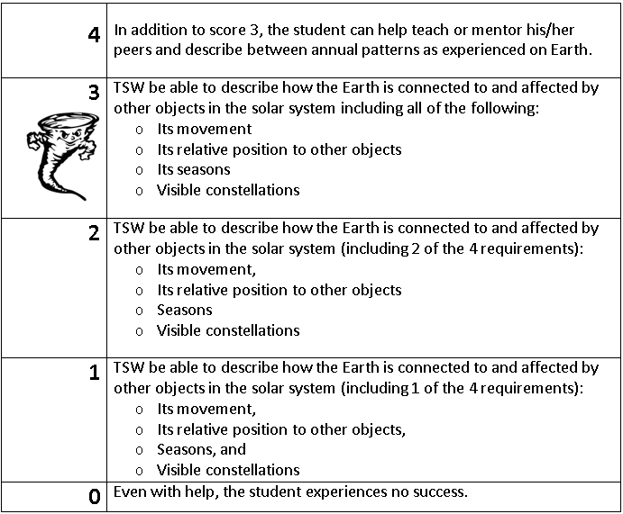
Learning Goal and Scale
TSW be able to describe how the Earth is connected to and affected by other objects in the solar system (including its movement, its relative position to other objects, its seasons, and visible constellations).

